Slide 1

CHURN Data analysis

Slide 2
OBJECTIVE
The Churn Analysis enables businesses to track customer leaving rates. This record helps businesses in enhancing customer loyalty and long-term profitability. Problem Identification: Churn Analysis studies the product and how people use that product. This helps in knowing the reason why people are leaving your product.
Predicting which set of the customers are going to churn out from the organization by analyzing the important variables. Analysing the churn data using the SQL tools, clean and process the data using Exploratory Data Analysis and predicting the Exited customers using Machine Learning Algorithms like Logistic Regression, Decision Tree, Random Forest, K-Nearest Neighbors and Naive Bayes Algorithm.

Slide 3
SQL ON THE CHURN DATA

Slide 4
QUESTION NO : 1
Query: SELECT DISTINCT * FROM churn.data LIMIT 10;
Methods Used: "SELECT" STATEMENT
"DISTINCT" STATEMENT
"LIMIT" CLAUSE
Explanation :
The SQL query consists of three separate "SELECT“ statements.
Each "SELECT" statement retrieves data from a table: "churn.data".
"DISTINCT" statement is used to return only distinct (different) values from the table.
The "LIMIT" clause allows users to control the amount of data retrieved and displayed in the result set.
This allows you to retrieve 10 distinct rows from the table.

Slide 5
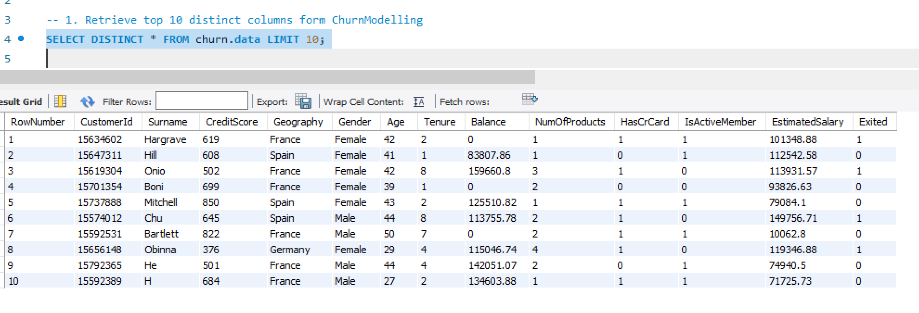

Slide 6
QUESTION NO : 2
Q2. Retrieving Count the number of customers who have exited.
Query : SELECT COUNT(*) AS ExitedCustomersCount FROM churn.data WHERE Exited = 1;
Methods Used: "SELECT" STATEMENT
"COUNT" FUNCTION
Explanation:
The SQL query consists of three separate "SELECT" statements.
Each "SELECT" statement retrieves data from a table: "churn.data".
"COUNT(*)" is an aggregate function used to count the number of rows in a table.
This allows you to retrieve counts of rows from a table.

Slide 7
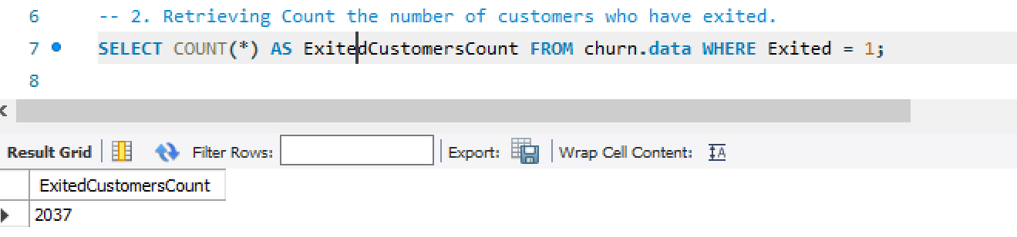

Slide 8
QUESTION NO: 3
Q3. Calculate the average balance by Geography.
Query: SELECT Geography, AVG(Balance) AS AvgBalance FROM churn.data GROUP BY Geography;
Methods Used: "SELECT" STATEMENT
"AVERAGE" FUNCTION
"GROUP BY" CLAUSE
Explanation:
"GROUP BY" clause groups the rows of the "churn.data" table by the values in the "Geography" column.
Therefore, the query calculates the AVERAGE of Balance for each geography and groups the data by geography.

Slide 9
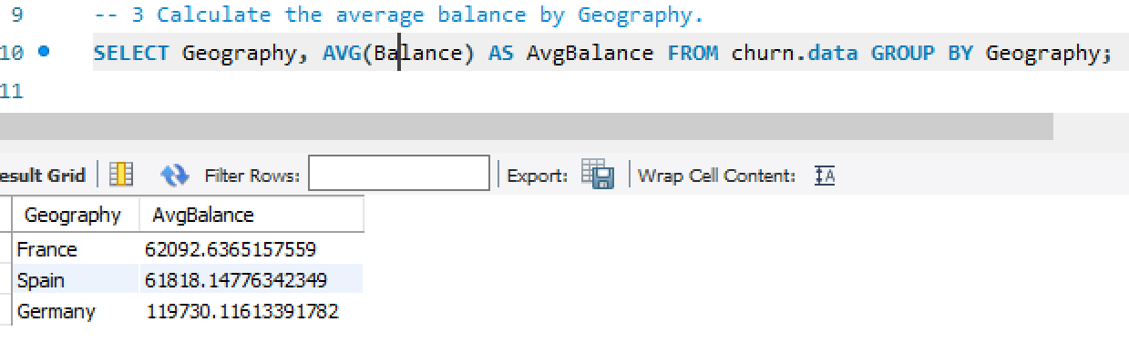

Slide 10
QUESTION NO: 4
Q4. Find customers with a credit score above the average credit score.(subquery)
Query: SELECT * FROM churn.data
WHERE CreditScore > (SELECT AVG(CreditScore) FROM churn.data);
Methods Used: "SELECT" STATEMENT
"AVERAGE" FUNCTION
Explanation:
"SELECT" statement retrieves data from a table: "churn.data".
"WHERE" CreditScore > is a condition that filters the rows to include only those where the CreditScore column has a value greater than subquery creditscore value.
This condition checks for transactions with negative total amounts, which typically indicates returns or refunds.

Slide 11
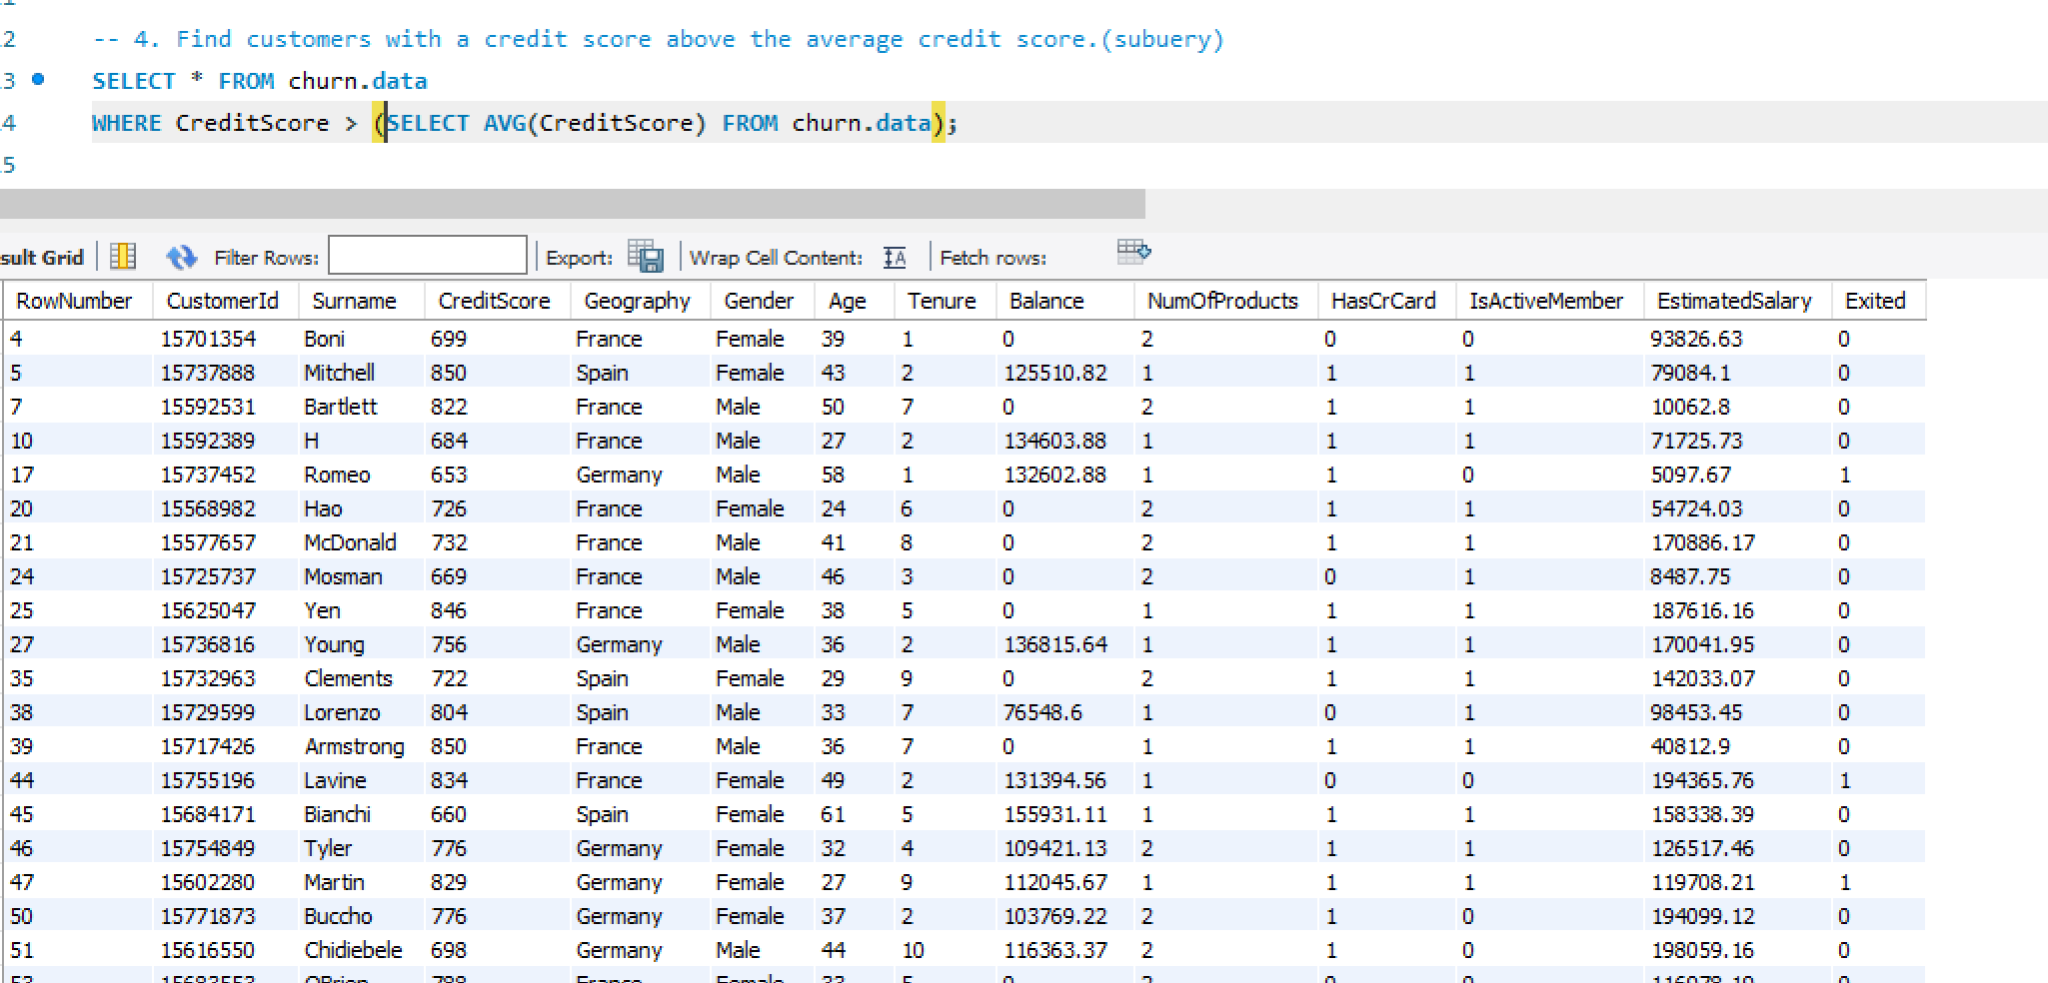

Slide 12
QUESTION NO: 5
Q5. Retrieve customers who are active members and have more than two products. (Conditional Retrieval)
Query: SELECT * FROM churn.data
WHERE IsActiveMember = 1 AND NumOfProducts > 2;
Methods Used: "SELECT" STATEMENT
"AVERAGE" FUNCTION
Explanation:
"SELECT" statement retrieves data from a table: "churn.data".
Where IsActiveMember = 1 AND NumOfProducts > 2 is a condition that checks the rows to include only those where the IsActiveMember is equal to 1 and Number Of Products greater than value 2
This condition checks for transactions with negative total amounts, which typically indicates returns or refunds.

Slide 13
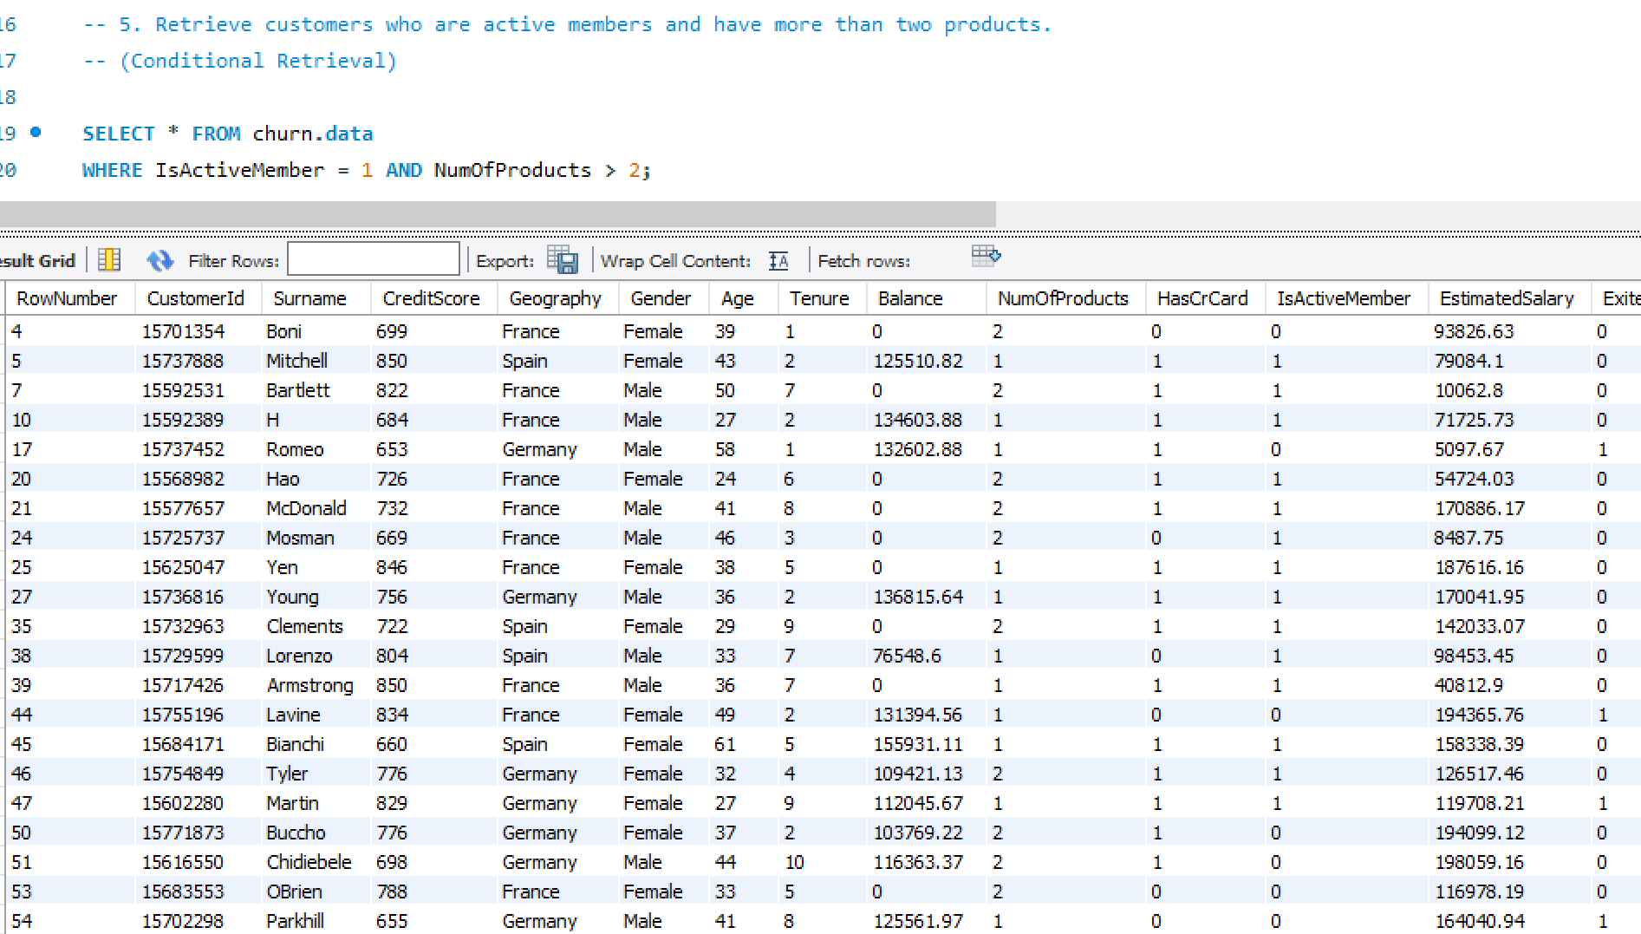

Slide 14
QUESTION NO: 6
Q6. Determine the average balance and estimated salary for different age groups.
Query: SELECT
CASE
WHEN Age < 30 THEN 'Under 30'
WHEN Age >= 30 AND Age < 40 THEN '30-39'
WHEN Age >= 40 AND Age < 50 THEN '40-49'
ELSE '50 and over'
END AS AgeGroup,
AVG(Balance) AS AvgBalance,
AVG(EstimatedSalary) AS AvgSalary
FROM churn.data
GROUP BY AgeGroup
ORDER BY AgeGroup;

Slide 15
Methods Used: "SELECT" STATEMENT
"AVERAGE" FUNCTION
"SWITCH" statement
"GROUP BY" CLAUSE
"ORDER BY" CLAUSE
Explanation:
CASE statement is a conditional expression that allows users to execute different actions based on different conditions.
here when it checks for 3 age groups which are under 30, greater than 30 and lesser than 40,value greater than 40 and lesser than 50 else over 50 age group.
Calculates the AVERAGE of balance column and renames it as AvgBalance
Calculates the AVERAGE of EstimatedSalary column and renames it as AvgSalary from table churn.data

Slide 16
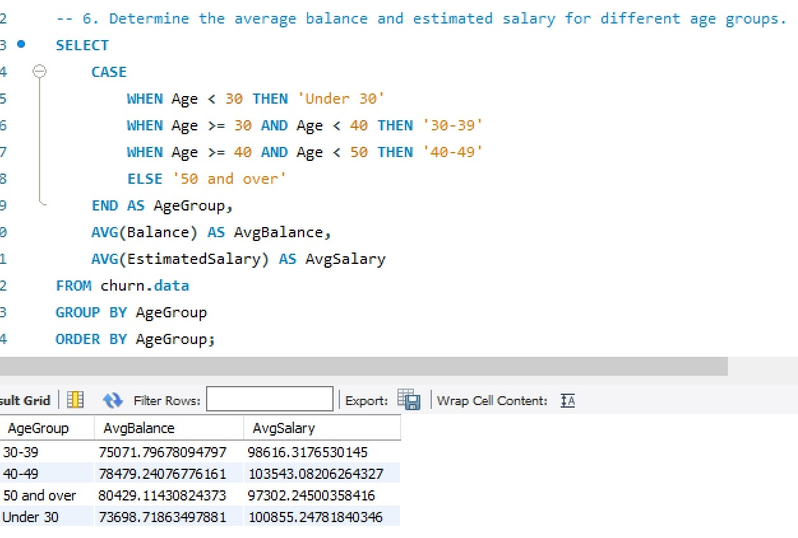

Slide 17
QUESTION NO: 7
Q7. Calculate the churn rate (percentage of customers who have exited) and analyze churn behavior based on various factors.
Query: SELECT
Geography,
AVG(Exited) AS ChurnRate,
AVG(CreditScore) AS AvgCreditScore,
AVG(Balance) AS AvgBalance
FROM churn.data
GROUP BY Geography
ORDER BY ChurnRate DESC;
Methods Used: "SELECT" STATEMENT
"AVERAGE" FUNCTION
"GROUP BY" CLAUSE
"ORDER BY" CLAUSE
Explanation:
Retrives the data by performing average of exited column, average of creditscore as avgcreditscore,, average of balance as avgbalance from churn.data by grouping geography column.

Slide 18
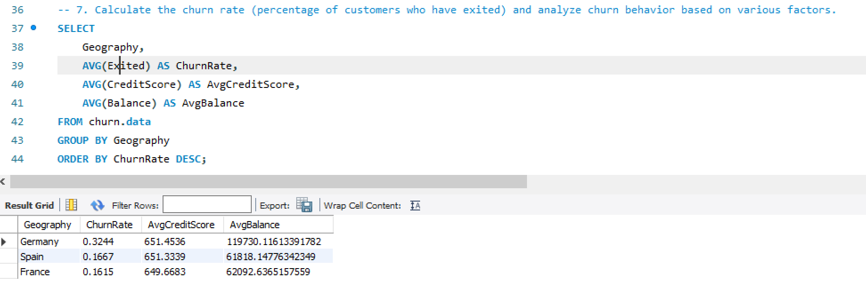

Slide 19
QUESTION NO: 8
Q8. Implement dynamic segmentation based on real-time updates in customer behavior, such as changes in balance or product ownership.Example using window functions for dynamic segmentation
Query: SELECT
CustomerId,
Balance,
NumOfProducts,
ROW_NUMBER() OVER (PARTITION BY CustomerId ORDER BY Balance DESC) AS Segment
FROM churn.data;
Methods Used: "SELECT" STATEMENT
"AVERAGE" FUNCTION
"ROW NUMBER() OVER()" function
Explanation:
ROW_Number() SQL RANK function to get a unique sequential number for each row in the specified data. It gives the rank one for the first row
and then increments the value by one for each row. We get different ranks for the row having similar values as well.

Slide 20
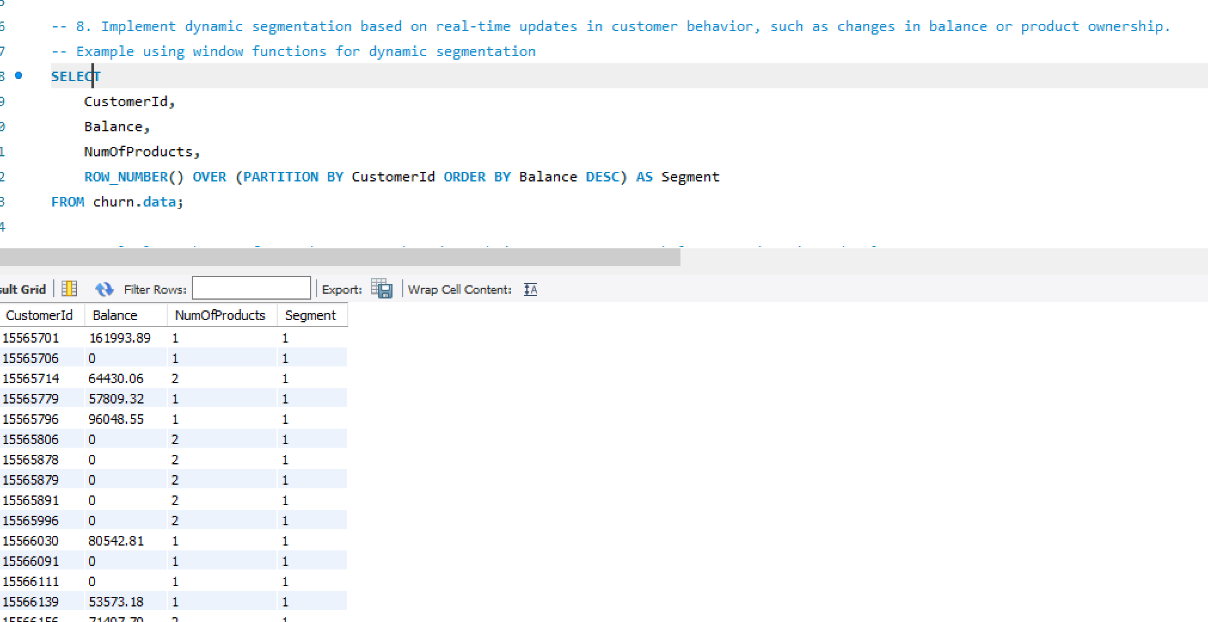

Slide 21
QUESTION NO: 9
Q9. Calculate the CLV for each customer based on their tenure, average balance, and estimated salary.
Query: SELECT
CustomerId,
SUM(Balance) AS TotalBalance,
AVG(EstimatedSalary) AS AvgSalary,
Tenure,
(SUM(Balance) / Tenure) * AVG(EstimatedSalary) AS CLV
FROM churn.data
GROUP BY CustomerId, Tenure
ORDER BY CLV DESC;
Methods Used: "SELECT" STATEMENT
"AVERAGE" FUNCTION
"SUM" FUNCTION
"GROUP BY" CLAUSE
Explanation:
Retrives sum of balance and Calculates the CLV(customer life time valve) for each customer based on their tenure, average balance, and estimated salary in descending order

Slide 22
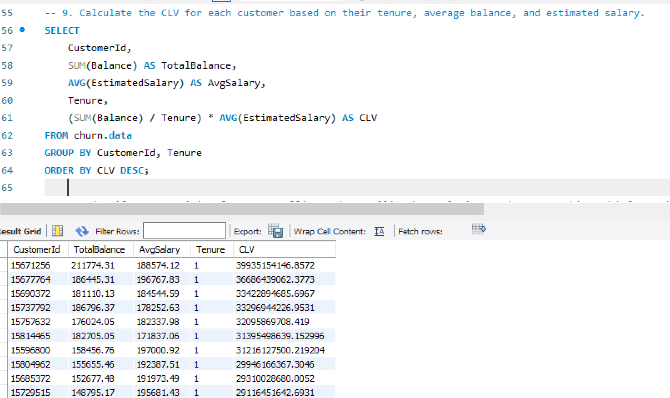

Slide 23
QUESTION NO: 10
Q10. Identify opportunities for cross-selling and up-selling by analyzing product ownership and balance distribution.
Query: SELECT
NumOfProducts,
AVG(Balance) AS AvgBalance,
COUNT(*) AS CustomerCount
FROM churn.data
GROUP BY NumOfProducts
ORDER BY NumOfProducts;
Methods Used: "SELECT" STATEMENT
"AVERAGE" FUNCTION
"GROUP BY" CLAUSE
Explanation:
Retreives cross-selling and up-selling of number of products by analyzing product ownership and balance distribution by grouping numberof products and orders by number of product

Slide 24
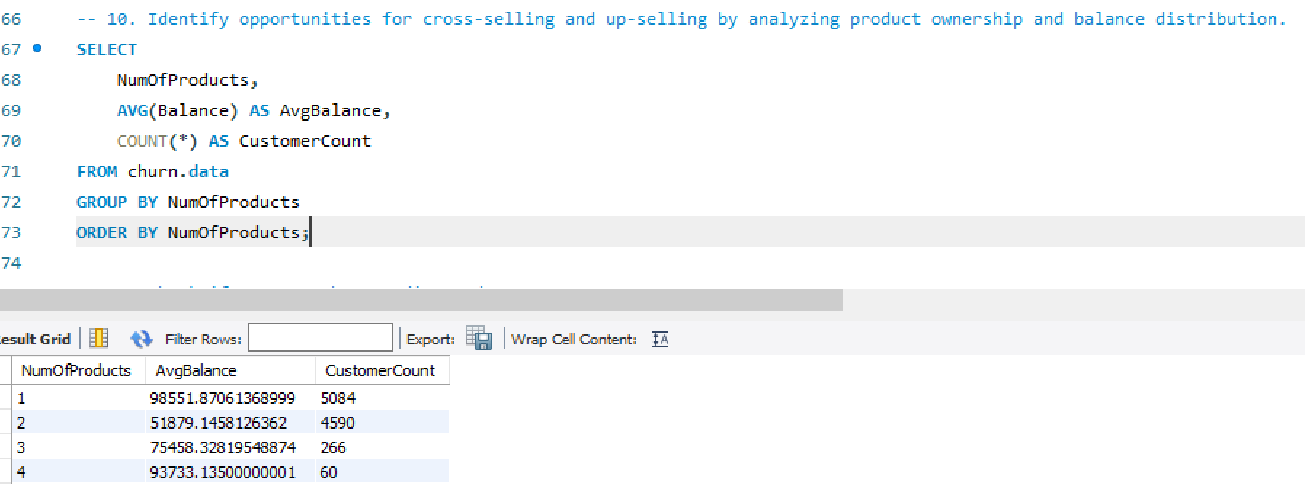

Slide 25
QUESTION NO: 11
Q11. Check if Customer has Credit Card
Create a UDF to convert the HasCrCard column (which is likely a bit or boolean) into a more readable format.
Query: DELIMITER //
CREATE FUNCTION HasCreditCard(hasCrCard BIT)
RETURNS VARCHAR(3)
BEGIN
DECLARE result VARCHAR(3);
SET result = CASE WHEN hasCrCard = 1 THEN 'Yes' ELSE 'No' END;
RETURN result;
END//
DELIMITER ;
SELECT CustomerId, Surname, HasCrCard, HasCreditCard(HasCrCard) AS HasCreditCard
FROM churn.data;
Methods Used: "SELECT" STATEMENT
"User Defined function“
Explanation:
A user-defined function (UDF) in SQL is a function that a user writes and the database software executes. UDFs can perform specific tasks, such as complex calculations or data processing. They can accept inputs, perform actions, and return the output in various forms, such as a single value or a result set.
Here UDF is created Check if Customer has Credit Card or not by specifying boolean condition.

Slide 26
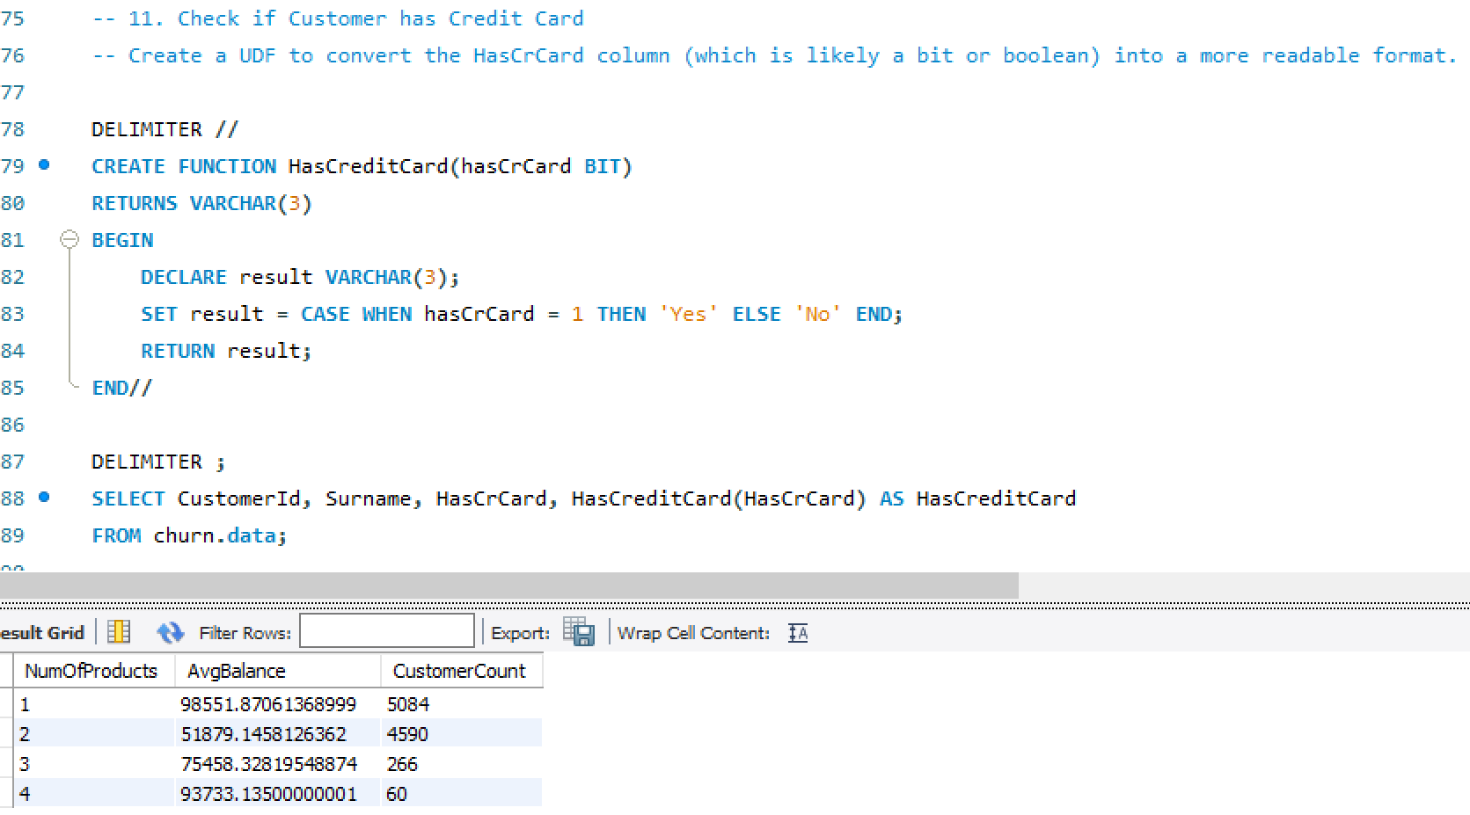

Slide 27
QUESTION NO: 12
Q12. Explore Customer Demographics and Churn
Objective: Investigate the relationship between customer demographics (gender, age) and churn.
Query: WITH DemographicsChurn AS (
SELECT
Gender,
Age,
AVG(Exited) * 100 AS ChurnRatePercentage
FROM churn.data
GROUP BY Gender, Age
)
SELECT Gender, Age, ChurnRatePercentage
FROM DemographicsChurn
ORDER BY Gender, Age;
Methods Used: "SELECT" STATEMENT
"CTE"
"AVERAGE" FUNCTION
"ORDER BY" CLAUSE
Explanation:
A Common Table Expression (CTE) in SQL is a temporary result set that can be referenced within a SELECT, INSERT, UPDATE, or DELETE statement. CTEs are defined using the WITH keyword and allow you to create a named, reusable subquery within your SQL statement
Here CTE is created to Explore Customer Demographics and Churn Objective by calculating ChurnRatePercentage

Slide 28
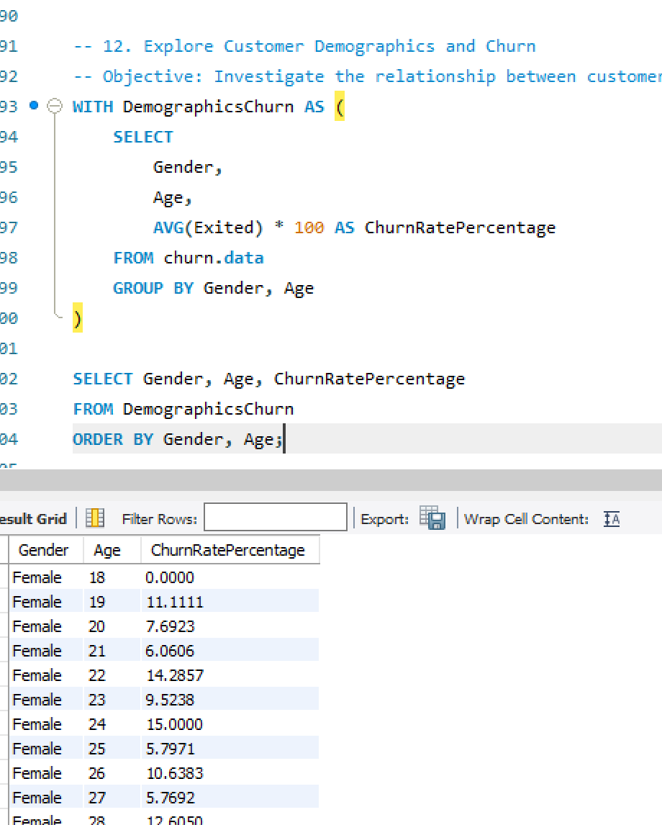

Slide 29
QUESTION NO: 13
Q13. Determine Customer Tenure and Estimated Salary Trends
Objective: Analyze the relationship between customer tenure and estimated salary.
Query: WITH TenureSalaryAnalysis AS (
SELECT
Tenure,
AVG(EstimatedSalary) AS AvgEstimatedSalary
FROM churn.data
GROUP BY Tenure
)
SELECT Tenure, AvgEstimatedSalary
FROM TenureSalaryAnalysis
ORDER BY Tenure;
Methods Used: "SELECT" STATEMENT
"CTE"
"AVERAGE" FUNCTION
"ORDER BY" CLAUSE
Explanation:
A Common Table Expression (CTE) in SQL is a temporary result set that can be referenced within a SELECT, INSERT, UPDATE, or DELETE statement. CTEs are defined using the WITH keyword and allow you to create a named, reusable subquery within your SQL statement
Here CTE is created to determine Customer Tenure and Estimated Salary Trends by Analyzing the relationship between customer tenure and estimated salary

Slide 30
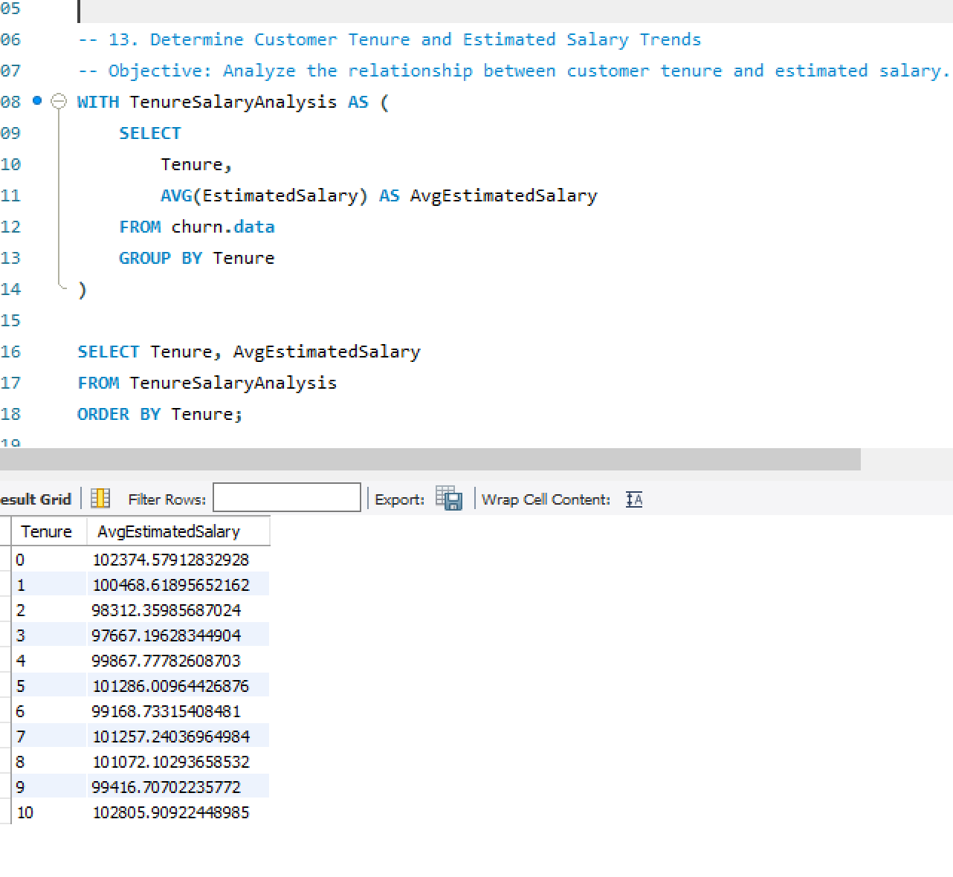

Slide 31
QUESTION NO: 14
Q14. Analyze Customer Age Distribution
Objective: Calculate the count of customers in different age groups.
Query:
WITH AgeDistribution AS (
SELECT
CASE
WHEN Age < 30 THEN 'Under 30'
WHEN Age >= 30 AND Age < 40 THEN '30-39'
WHEN Age >= 40 AND Age < 50 THEN '40-49'
ELSE '50 and over'
END AS AgeGroup,
COUNT(*) AS CustomerCount
FROM churn.data
GROUP BY AgeGroup
)
SELECT AgeGroup, CustomerCount
FROM AgeDistribution
ORDER BY AgeGroup;

Slide 32
Methods Used: "SELECT" STATEMENT
"CTE"
"AVERAGE" FUNCTION
"ORDER BY" CLAUSE
Explanation:
A Common Table Expression (CTE) in SQL is a temporary result set that can be referenced within a SELECT, INSERT, UPDATE, or DELETE statement. CTEs are defined using the WITH keyword and allow you to create a named, reusable subquery within your SQL statement
Here CTE is created to Analyze Customer Age Distribution in various groups and Calculating the count of customers in different age groups.

Slide 33
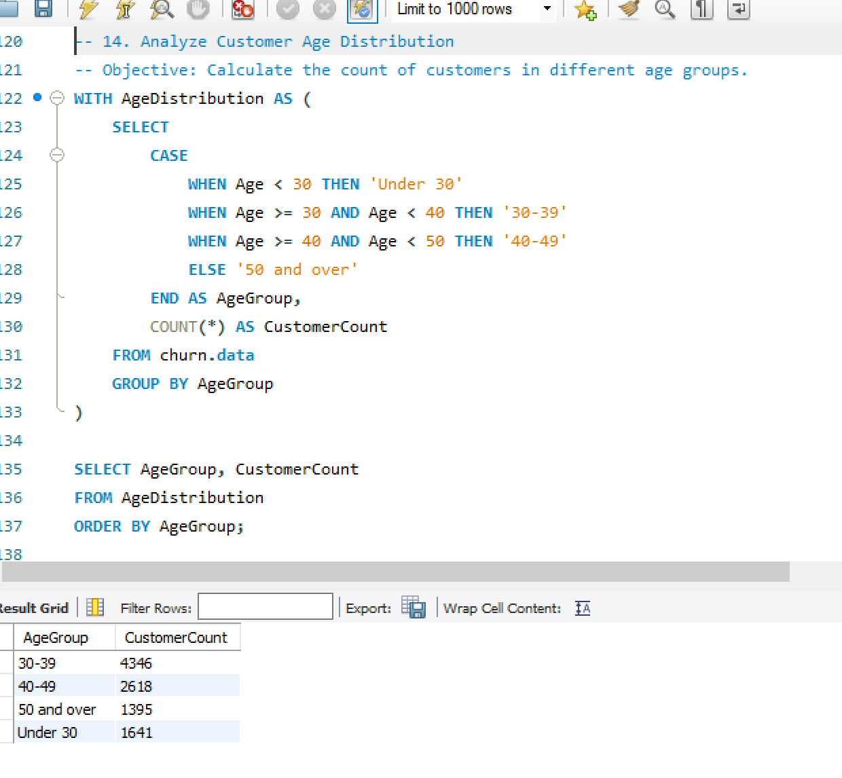

Slide 34
QUESTION NO: 15
Q15. How many customers having a credit score between 600 and 700 are male and female? And also tell what is the average salary of male customers and female customers in that Credit Score bracket?
Query: select Gender,count(CustomerId) as No_of_customers,round(avg(EstimatedSalary),2) as Average_Salary from churn.data
where CreditScore between 600 and 700
group by Gender
Methods Used: "SELECT" STATEMENT
"ROUND" FUNCTION
"COUNT" FUNCTION
"AVERAGE" FUNCTION
"GROUP BY" CLAUSE
Explanation:
To Retreive the values calculated for customers having a credit score between 600 and 700 are male and female and also calculating the average salary of male customers and female customers in that Credit Score

Slide 35
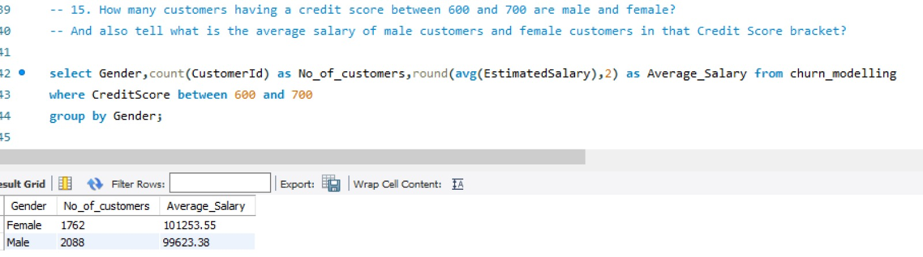

Slide 36
QUESTION NO: 16
Q16. How many male and female customers have been churned out in different Countries in different age brackets?
# age is between 18 and 30 .....Young
# age is bweteen 30 to 45.....Adults
# age is between 45 to 60.....MiddlE_Aged
#>60..........................Senior_Citizens
Query: with ABC as
(select *,
case when Age>=18 and Age<30 then "Young"
when Age>=30 and Age<45 then "Adult"
when Age>=45 and Age<60 then "Middle_Aged"
else "Senior_Citizen"
end as Age_bracket
from churn.data)
select Gender,Geography,Exited,count(CustomerID) as Churned_customers from ABC
group by Gender,Geography,Exited
having Exited = 1
order by Gender, Geography;

Slide 37
Methods Used: "SELECT" STATEMENT
"CTE"
"AVERAGE" FUNCTION
"ORDER BY" CLAUSE
Explanation:
A Common Table Expression (CTE) in SQL is a temporary result set that can be referenced within a SELECT, INSERT, UPDATE, or DELETE statement. CTEs are defined using the WITH keyword and allow you to create a named, reusable subquery within your SQL statement
Here CTE is created to verify male and female customers have been churned out in different Countries in different age brackets as Young, Adults, Middle aged and Senior_Citizens

Slide 38
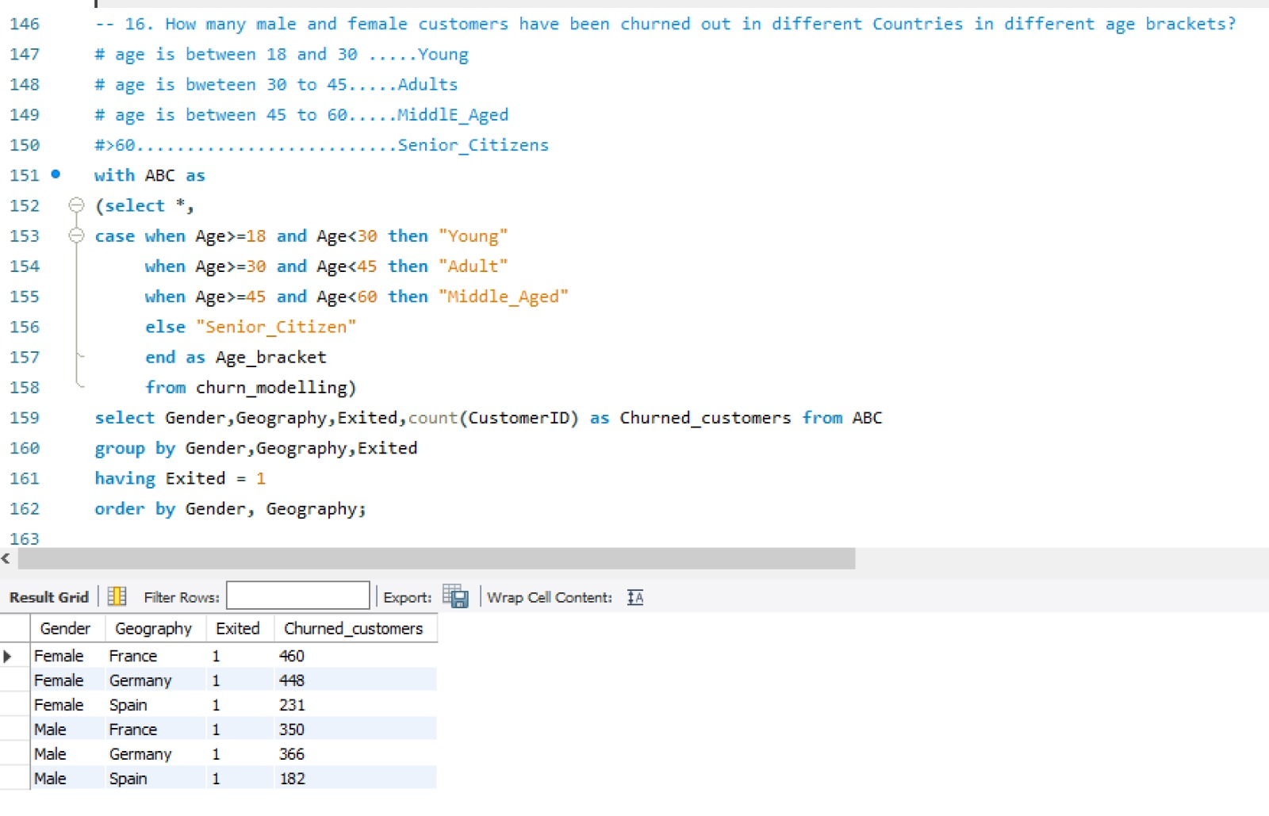

Slide 39
EXPLORATORY DATA ANALYSIS ON THE churn DATA

Slide 40
OBJECTIVES
Importing all the necessary modules.
Importing the data from an external source into the Python environment.
Renaming the variables as per the Naming conversion.
Performing necessary Data type Conversions on the data.
Checking the relevant and irrelevant variables in the first phase of EDA.
Data Duplicacy: Check if their is duplicate data or not: DDT ( Data Duplicacy Treatment)
Missing Values Treatment.
Separating the categorical Variables and Numerical variables into two different datasets for Data Preparations for Data Analysis.
Filling missing values in Numerical data with the Median values.
Filling missing values in Categorical data with the Mode values.
Visualizing relationship of variables using Matplotlib.pyplot
Outlier Treatment.

Slide 41
Importing all the necessary modules.
To importing necessary modules in python, we use “import” statement followed by the name of the module.
numpy : it is used for numerical computing. It provides support for large, multi-dimensional arrays and matrices. In numpy data structure allows Broadcasting and Vectorization
Importing numpy: import numpy as np
pandas: it is a powerful library in python for data manipulation and analysis. It provides data structure like data frame and series.
Importing pandas: import pandas as pd
Matplotlib.pyplot : which is used for creating static,interactive and visualization in python.

Slide 42
Matplotlib offers a wide range of plotting functions to create various types of plots such as Line plot, Scatter plot, Bar plot, Histogram and Pie chart.
Importing matplotlib: import matplotlib.pyplot as plt
Datetime: for the datetime data we import datetime.
Importing datetime : import datetime as dt
seaborn : it is a statistical data visualization module.
Seaborn simplifies the creation of complex visualization.
Box plot, Tree map, Heat maps are used to check correlations between multiple variables.
Importing seaborn : import seaborn as sns
Statsmodels: This module provides a high-level interface for specifying statistical modules using a formula.

Slide 43
Importingstats models : import statsmodels.formula.api as smf
Sklearn: it can implement and evaluate a wide range of ML models with ease, leveraging its robust and efficient algorithms and utilities.
Importing Sklearn :fromsklearn import datasets, linear_model
Importing Machine Learning modules:
Logistic Regression:
from sklearn.linear_model import LogisticRegression
from sklearn.metrics import accuracy_score,confusion_matrix,classification_report,roc_auc_score,roc_curve
from sklearn.metrics import f1_score, roc_auc_score, confusion_matrix, accuracy_score

Slide 44
Decision Tree: from sklearn.tree import DecisionTreeClassifier from sklearn.metrics import confusion_matrix from sklearn.tree import DecisionTreeClassifier, export_graphviz, export_text from sklearn.neighbors import KNeighborsClassifier from sklearn.model_selection import GridSearchCV, train_test_split from sklearn.preprocessing import StandardScaler, minmax_scale K-Nearest Neighbors Classifier: from sklearn.neighbors import KNeighborsClassifier from sklearn.model_selection import GridSearchCV, train_test_split from sklearn.preprocessing import StandardScaler, minmax_scale Random Forest Classifier: from sklearn.ensemble import RandomForestClassifier Naive Bayes Algorithm: from sklearn.naive_bayes import GaussianNB gnb = GaussianNB()

Slide 45
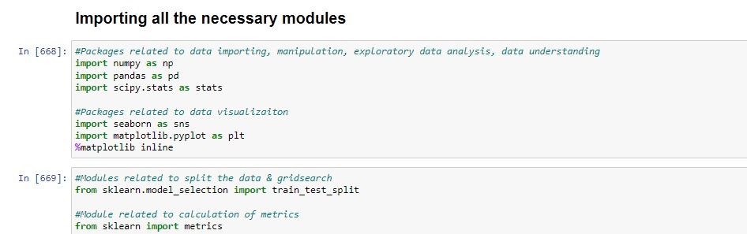

Slide 46
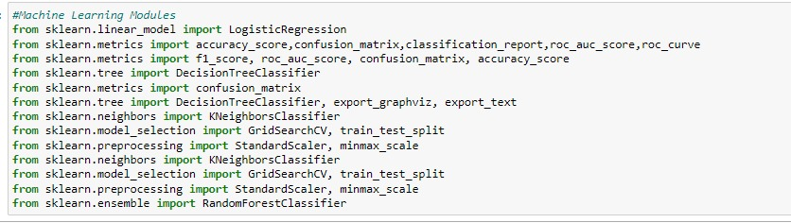

Slide 47
Importing the data from an external source into the Python environment
To import data from an external source into a python environment, we use various methods depending on the type and format of the data.
In this project data is in the format of csv file. To read csv files using the read_csv() function

Slide 48
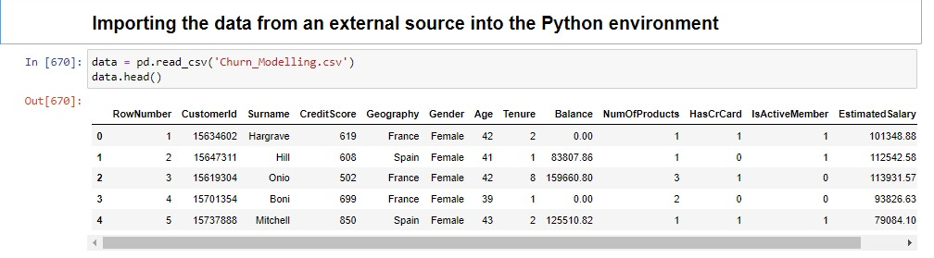

Slide 49
Renaming the variables as per the Naming conversion.
According to the naming conversion :
Names should be starting with alphabets.
Do not use special characters except underscore.
There is no spacing between the names.

Slide 50
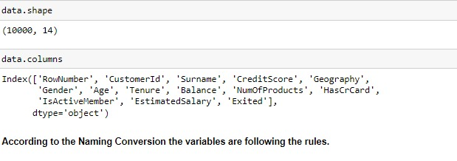

Slide 51
In this Data follows the naming conversion
Getting the summary of the data frame , data.info() is used to get the concise summary of the Data frame.
It provide information such as :
The total number of entries in each column.
The data type of each column.
The count of non-null values in each column.
The memory usage of the data frame

Slide 52
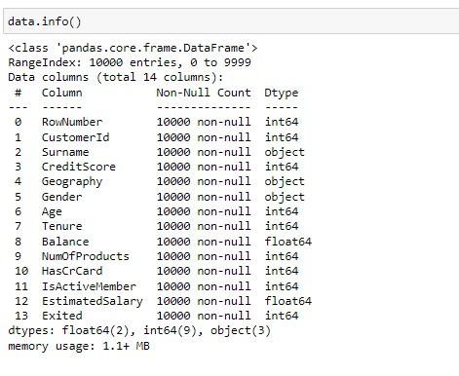

Slide 53
Data Duplicacy : Check if their is duplicate data or not: DDT (Data Duplicacy Treatment)
In this churn data there is no duplicate values. The data contain 10000 records and 14 variables.

Slide 54
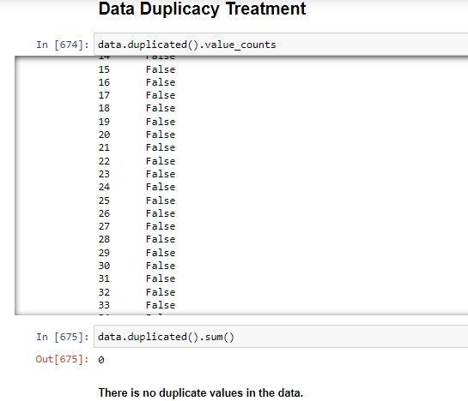

Slide 55
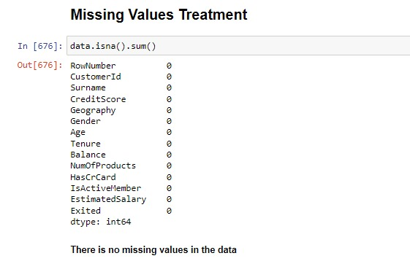
MISSING VALUE TREATMENT There is no missing values in this data

Slide 56
checking the value count and nunique of categorical variables
In the first phase of Exploratory Data Analysis (EDA), determining relevant and irrelevant variables is crucial for understanding the dataset and shaping further analysis.
Data.nunique() is used to count the number of unique values in a data frame or series.
Value _counts() is used to count the occurrences of unique values .

Slide 57
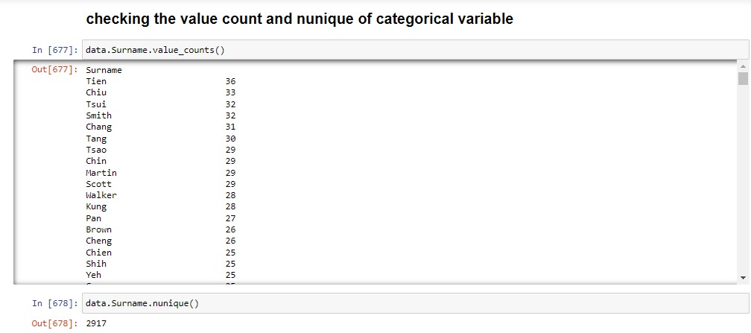

Slide 58
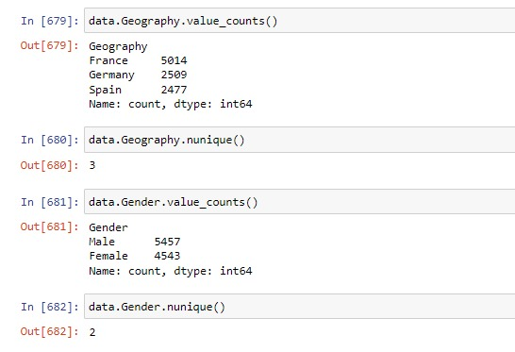

Slide 59
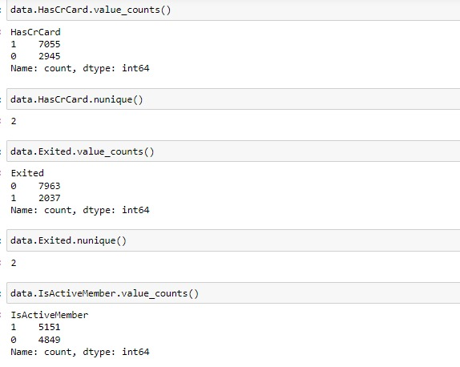

Slide 60
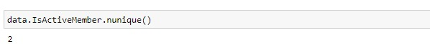

Slide 61
Visualizing relationship of variables using Matplotlib.pyplot.
Matplotlib.pyplot : which is used for creating static, interactive and visualization in python.
Matplotlib offers a wide range of plotting functions to create various types of plots such as Line plot, Scatter plot, Bar plot, Histogram and Pie chart.
Line plot: Line plot display data points connected by straight line segment. It commonly used to visualize the relationship or trends.
Scatter plot: Scatter plot is used to show the correlation between two numerical variables.
Bar plot: Bar plot is used for comparison analysis. It shows the relation between one numerical variable and one categorical variable.
Histogram: Histograms are very helpful to see the frequency distribution by only numerical variable.
Pie chart: used for showing the percentage distribution of a numerical variable by one categorical variable.

Slide 62
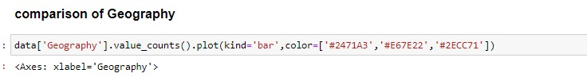
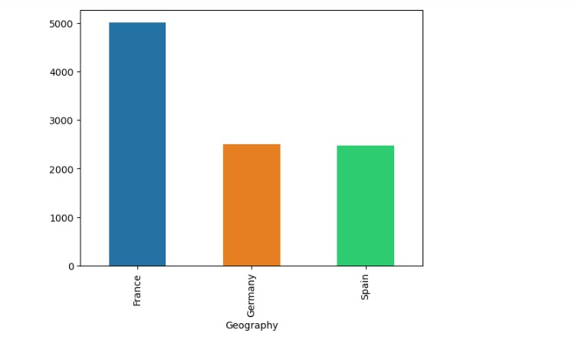

Slide 63
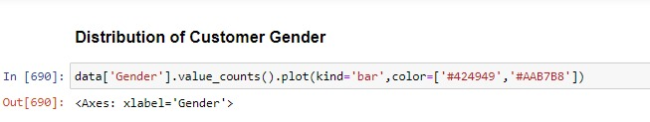
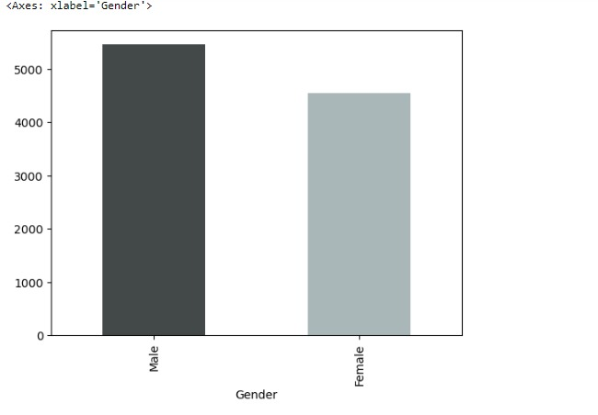

Slide 64
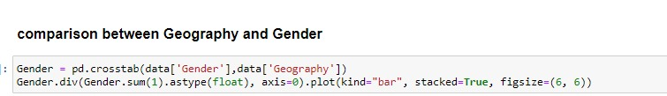
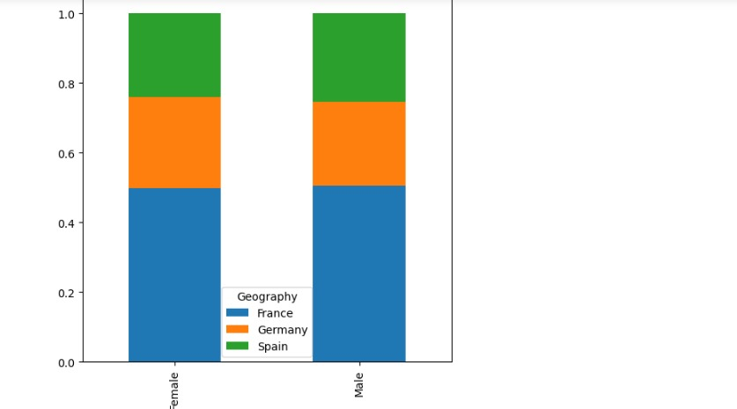

Slide 65
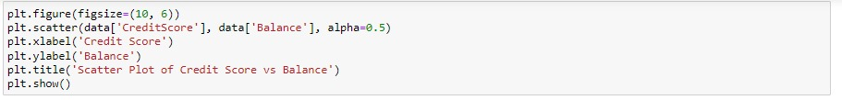
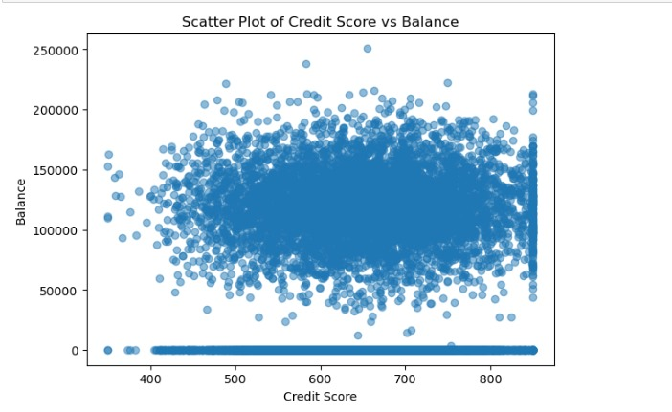

Slide 66
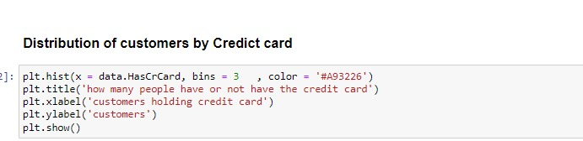
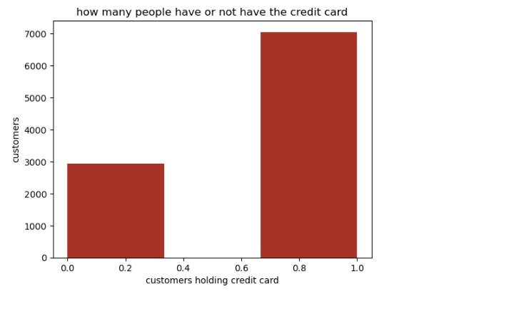

Slide 67
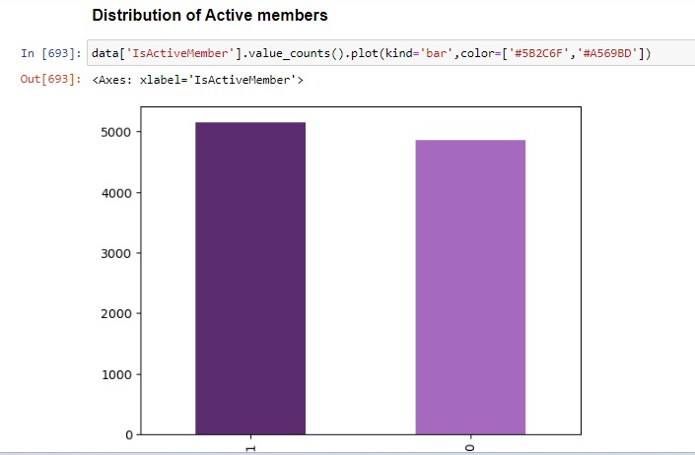

Slide 68
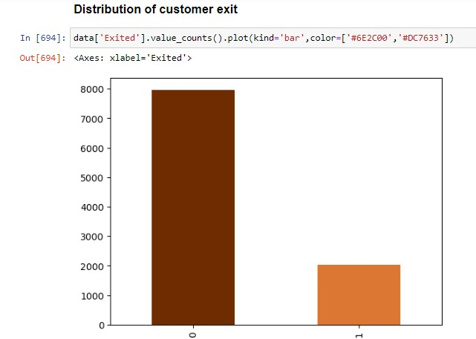

Slide 69
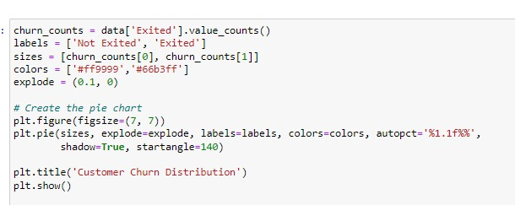
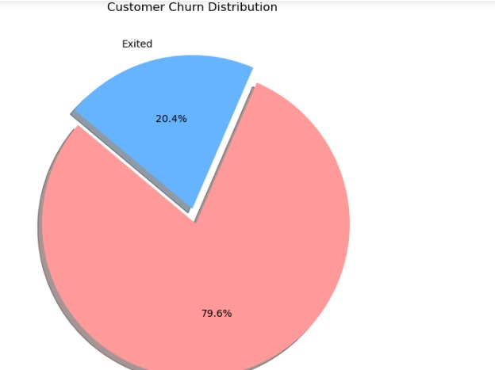

Slide 70
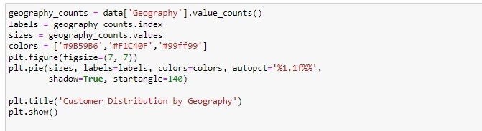
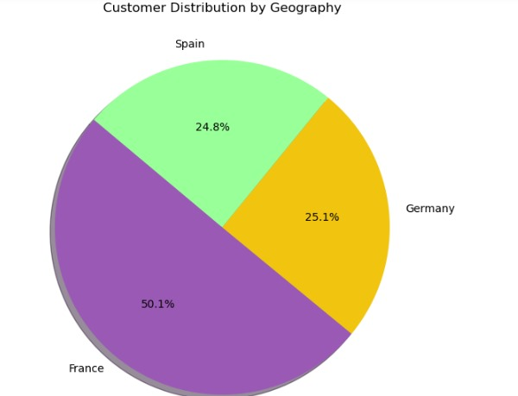

Slide 71
Separating the categorical Variables and Numerical variables into two different datasets for Data Preparations for Data Analysis There 3 categorical variable and 11 numerical variables

Slide 72
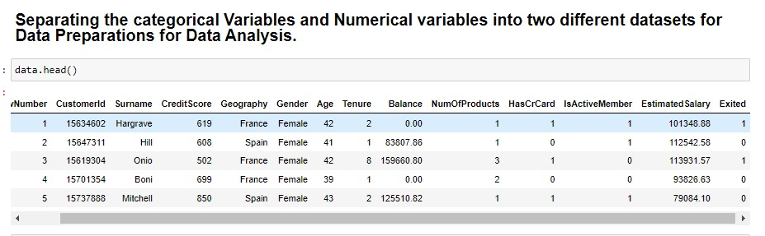

Slide 73
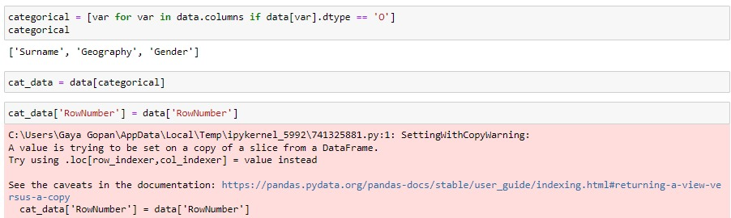
There are 3 Categorical Variables and 11 Numerical Variables.

Slide 74
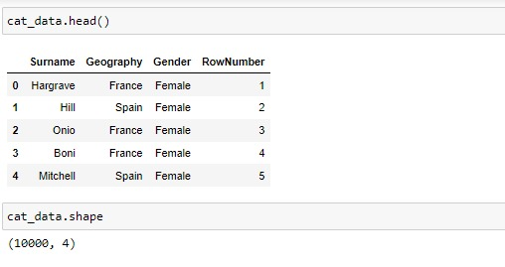

Slide 75
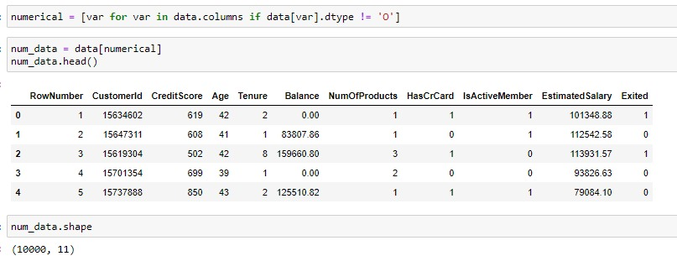

Slide 76
OUTLIER TREATMENT
In python outlier is a data point that significantly differ from other observations in a dataset.
Outlier is a value either very large or either very small.
To perform outlier treatment using the interquartile range (IQR) method .
Mean of the data gets affected by the outlier and median not affected much.

Slide 77
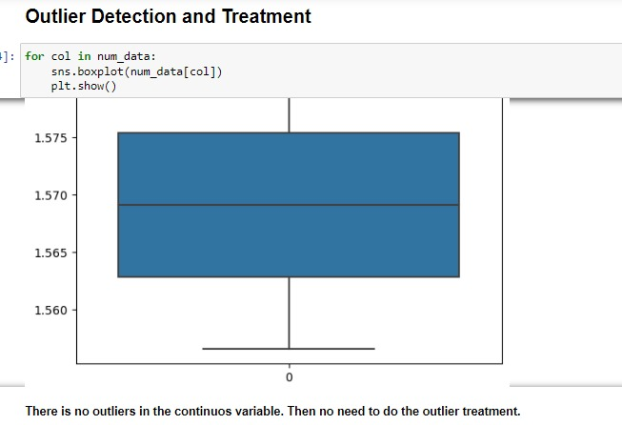

Slide 78
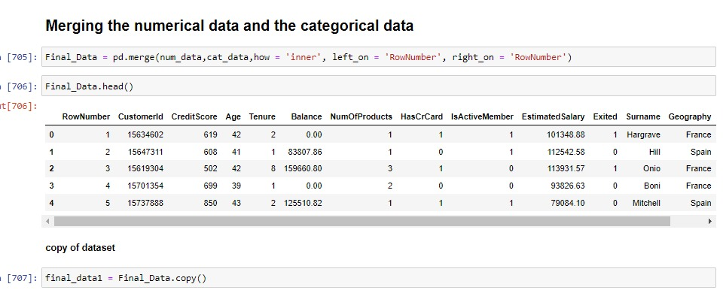
Merging the numerical data and the categorical data

Slide 79
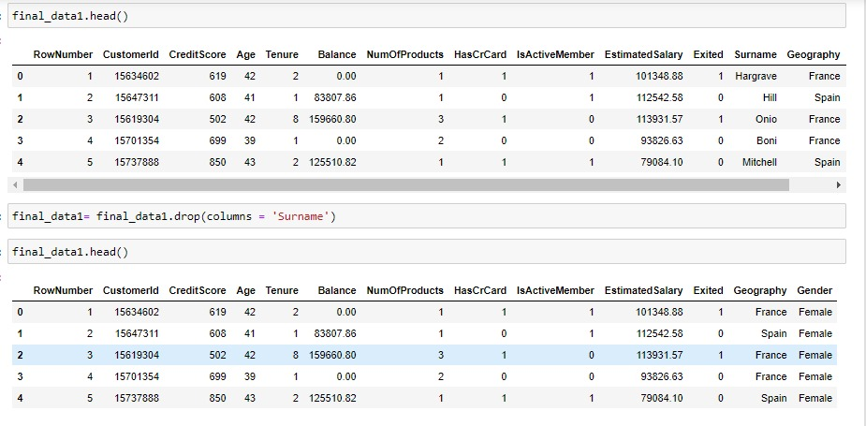
After merging the numeric and categorical data we get Final Data Make A Copy Of Final Data To Safe The Original Data.

Slide 80
ONE-HOT ENCODING
One-hot encoding is a technique used to convert categorical variables into a numerical format that can be used in machine learning models. It creates a binary column for each category and assigns a 1 or 0 to indicate the presence of a category in a given sample.
creating dummy variables is a crucial step in preprocessing categorical data for machine learning models, ensuring that the data is in a suitable numerical format without imposing any unintended order or hierarchy.

Slide 81


Slide 82
Feature Engineering
Feature Engineering is a part of EDA in which we try to remove the less important feature and take only the relevant and important variable or feature.
Correlation Analysis :
The correlational coefficient indicates the strength and direction of the relationship.
The range of correlational analysis is -1 to 1.
1 indicates perfect positive correlation.
-1 indicates perfect negative correlation.
0 indicates no linear relationships.
Selecting the important feature by choosing a cut of value of 0.03
e Engineering is a part of EDA in which we try to remove the less important feature and take only the relevant and important variable or feature.

Slide 83


Slide 84


Slide 85


Slide 86


Slide 87


Slide 88
Splitting the final dataset into Training and Testing dataset
Divide the dataset into separate subset for Training, Validation, Testing dataset.
Training dataset :
The largest portion of the dataset (70-80% of total dataset).
Learn patterns, relationships and characteristics from the set.
Validation dataset :
10-15% of the dataset.
Optimizing model performance without overfitting the training data.
Testing dataset :
Evaluating the final model’s performance on unseen data.
10-15% of the total data.

Slide 89


Slide 90
MODELLING
MACHINE LEARNING ALGORITHMS:
Logistic Regression
Decision Tree
K-Nearest Neighbors Classifier
Random Forest
Naive Bayes

Slide 91


Slide 92


Slide 93


Slide 94


Slide 95


Slide 96


Slide 97


Slide 98


Slide 99


Slide 100

COMPARISON ANALYSIS

Slide 101


Slide 102
CONCLUSION - dhiv -Dhivya
The Chun data modeling analysis provided valuable insights into the strengths and weaknesses of various machine learning algorithms.
By carefully evaluating and comparing these models, Naïve Bayes algorithm is gives the best model. The Chun data modeling analysis provided valuable insights into the strengths and weaknesses of various machine learning algorithms.
By carefully evaluating and comparing these models, Naïve Bayes emerged as the most effective solution for predicting churn out customers.
The findings underscore the importance of considering multiple aspects, including performance, efficiency, robustness, and interpretability, in the model selection process.
Moving forward, continuous improvement and adaptation will be key to leveraging the full potential of the chosen model.

Slide 103
THANK YOU
- Dhivya Mohan

